Slide 1
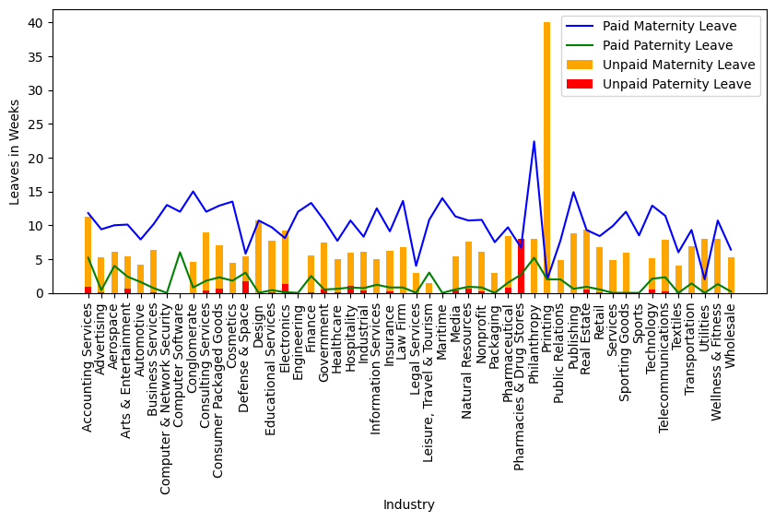
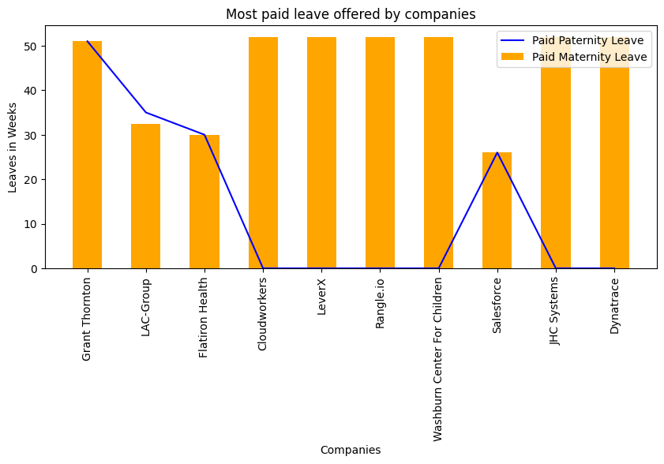
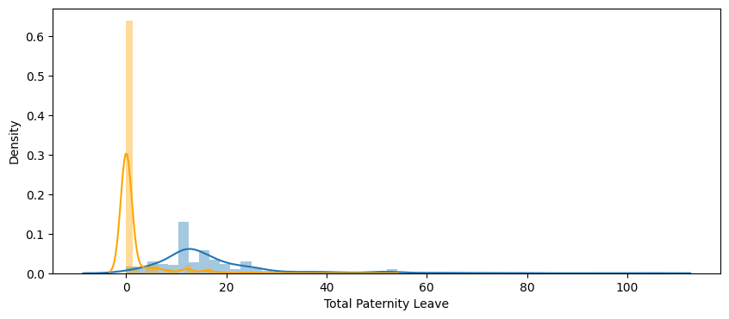
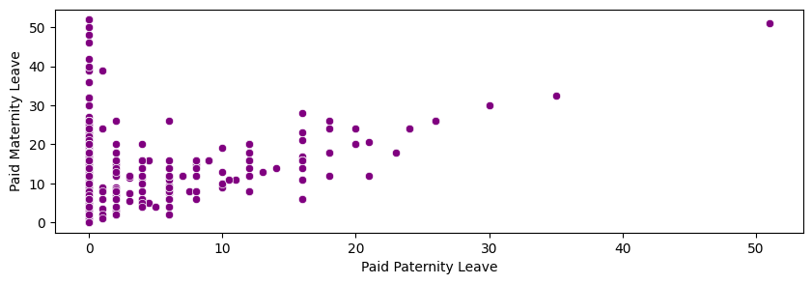
Parental Leave Policies

Slide 2
Which companies offer the most paid parental leave weeks?
Grant Thornton
LAC-Group
Flatiron Health
Cloudworkers
LeverX
Rangle.io
Washburn Center For Children
Salesforce
JHC Systems
Dynatrace

Slide 3
2. Is maternity leave typically longer than paternity leave?
As we can see in the above scatter plot, most of the company is providing Maternity Leave and does not offers Paternity leave or while some of the companies provide less paternity leave than maternity leave.
So, We can say Maternity Leave is longer than Paternity Leave.

Slide 4
3. What is the distribution of parental leave weeks offered?
Average Maternity Leave: 17.1 and Std of Maternity Leave: 12.5 Average Paternity Leave: 1.6 and Std of Maternity Leave: 4.8
Distribution of both Maternity and Paternity Leave is almost seems like normal distribution with very less skewed to the right.
std for maternity leave is greater than paternity leave. and spread of the data in maternity leave is more and wide than that of paternity leave as more than 50% data in paternity leave is very close to mean. And in maternity data the data is spreaded over some std value.

Slide 5
4. Are there noticeable differences between industries?
In every Industry Paid Maternity leave is longer than Paid Paternity leave.
Also Unpaid Maternity Leave is longer than Unpaid Paternity Leave.
Only Pharmacies and Drug Stores offers equal Unpaid Maternity as well as Paternity Leave.
Printing Industry offers same weeks of Paid Maternity and Paternity Leave. Also it offers highest no. of unpaid week leave

Slide 6
Thank You

